Slide 1
WEB ENGINEERING
CSE417 Section: A

Slide 2




Website Audit
Ms. Sharmin Akter
Lecturer,
Department of CSE,
Daffodil International University
Submitted To:
Sourav Sen Gupta
182-15-11392
Mohammad Shoaib
182-15-11722
Md. Abdullah Al Masud Siddque
182-15-11471
Team Members:

Slide 3
TABLE OF CONTENTS
01
04
Objective
Application/Process
complete and detailed analysis effectiveness of a site
process and types of website audit
02
05
Introduction
Real Life Example
what is website audit?
some real uses of website audit
03
06
Motivation
complete and detailed analysis effectiveness of a site
Conclusion
overall summary

Slide 4
OBJECTIVE
complete and detailed analysis
effectiveness of a site
scope of further optimizations
process of auditing
improve Google search ranking
keep businesses agile and aligned
some real life scenarios

Slide 5
INTRODUCTION
What is Website Audit?

Slide 6

MOTIVATION
Website Performance Optimization
Search Engine Optimization
Conversion Rate Optimization

Slide 7
APPLICATION/PROCESSES
Processes of website Audit
Types of Website Audit

Slide 8
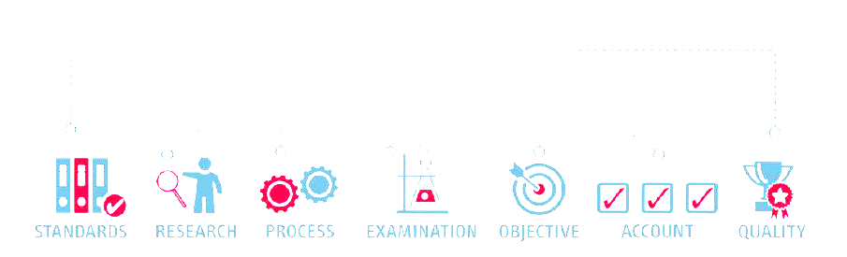
Processes of website Audit:
Choose a Site Audit Tool
Run Website URL Through the Audit Tool
Find Technical Errors
Identify SEO Problems
Analyze Design and UX
Assess Website Content
Generate a Checklist of all Issues

Slide 9
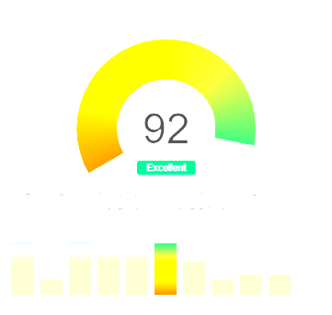
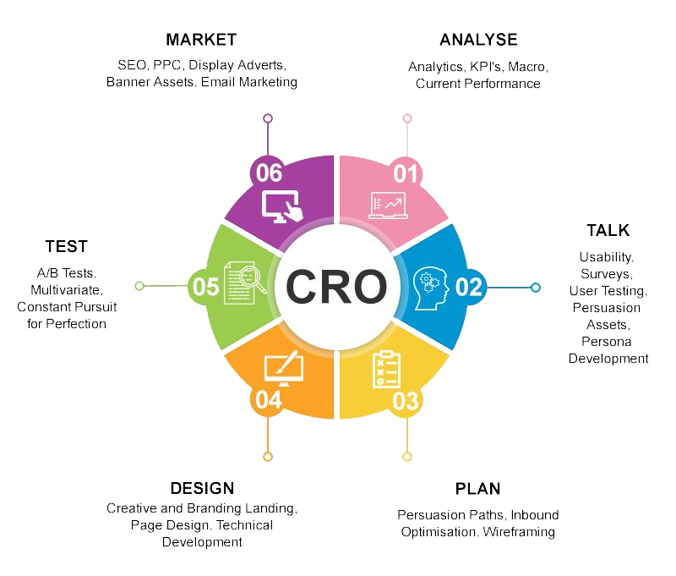
Types Of Website Audit
Site Health Audit
Conversion Rate Optimization Audit

Slide 10
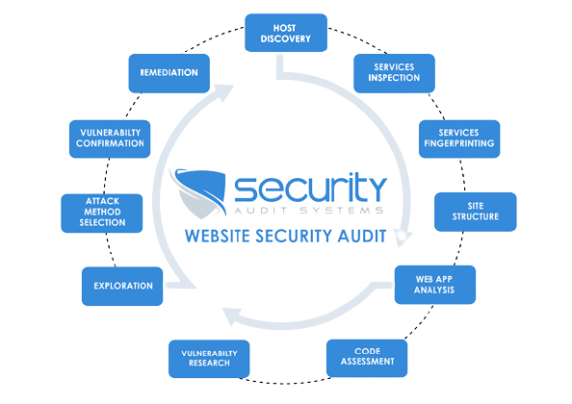

Types Of Website Audit
2021
Website Security Audit
Social Media Presence Audit

Slide 11

Types Of Website Audit
Competitor Website Audit

Slide 12

Real Life Example
Factors
Duplicate Title Tag
Missing Title Tag
Long Title Tag
Multiple Title Tag
Host Name

Slide 13

Real Life Uses
Questions to answer
Is your website secured by an SSL certificate?
Does your website load when typing in various URLs?
Has google taken any manual actions against your website?
Is google listing crawl errors for your website?
Can search engines index your site pages?
Does all pages in your website have an SEO title and meta description?

Slide 14

Conclusion

Slide 15
THANKS!

Slide 16
REFERENCES
https://en.wikipedia.org/wiki/Website_audit
Analyze Websites With Free SEO Audit & Reporting Tool - SEOptimer
What Is A Website Audit and Why Are They SO Important? | All Things Web
Site Audit: Improve the SEO of Your Website | Semrush
https://sitechecker.pro/
The 10 Amazing Impact and Importance of SEO Website Audit to Look For - A1 Future Technologies - Blog

